Slide 1
Understanding the File system
Block placement
Current Strategy
One replica on local node
Second replica on a remote rack
Third replica on same remote rack
Additional replicas are randomly placed
Clients read from nearest replica
Data Correctness
Use Checksums to validate data
Use CRC32
File Creation
Client computes checksum per 512 byte
DataNode stores the checksum
File access
Client retrieves the data and checksum from DataNode
If Validation fails, Client tries other replicas
Notes:
11

Slide 2
Understanding the File system
Data pipelining
Client retrieves a list of DataNodes on which to place replicas of a block
Client writes block to the first DataNode
The first DataNode forwards the data to the next DataNode in the Pipeline
When all replicas are written, the Client moves on to write the next block in file
Rebalancer
Goal: % of disk occupied on Datanodes should be similar
Usually run when new Datanodes are added
Cluster is online when Rebalancer is active
Rebalancer is throttled to avoid network congestion
Command line tool
Notes:
22

Slide 3
Basic Hadoop Filesystem commands
In order to work with HDFS you need to use the hadoop fs command. For example to list the /
hadoop fs –ls /
hadoop fs –ls /user/root
hadoop fs –lsr /user
For make the directory test you can issue the following command
hadoop fs –mkdir test
In order to move files between your regular linux filesystem and HDFS
hadoop fs –put /test/README README
To see a new file called /user/root/README listed. In order to view the contents of
this file we will use the –cat command as follows
hadoop fs –cat README
To find the size of files you need to use the –du or –dus commands
hadoop fs –du README
movefromLocal
Hadoop fs -moveFromLocal <src> <dst>

Slide 4
Copy single src, or multiple srcs from local file system to the destination filesystem.
hadoop dfs -put localfile /user/hadoop/hadoopfile
copyFromLocal
hadoop fs -copyFromLocal <localsrc> URI
copyToLocal
hadoop fs -copyToLocal [-ignorecrc] [-crc] URI <localdst>
cp
Copy files from source to destination. This command allows multiple sources as well in which case the destination must be a directory.
hadoop fs -cp /user/hadoop/file1 /user/hadoop/file2
hadoop fs -cp /user/hadoop/file1 /user/hadoop/file2 /user/hadoop/dir
get
Copy files to the local file system. Files that fail the CRC check may be copied with the -ignorecrc option. Files and CRCs may be copied using the -crc option.
hadoop fs -get /user/hadoop/file localfile
hadoop fs -get hdfs://host:port/user/hadoop/file localfile

Slide 5
rm
Usage: hadoop dfs -rm URI [URI …]
Delete files specified as args. Only deletes non empty directory and files. Refer to rmr for recursive deletes. Example:
hadoop dfs -rm hdfs://host:port/file /user/hadoop/emptydir
Exit Code:
Returns 0 on success and -1 on error.
rmr
Usage: hadoop dfs -rmr URI [URI …]
Recursive version of delete. Example:
hadoop dfs -rmr /user/hadoop/dir
hadoop dfs -rmr hdfs://host:port/user/hadoop/dir
Exit Code:
Returns 0 on success and -1 on error.

Slide 6
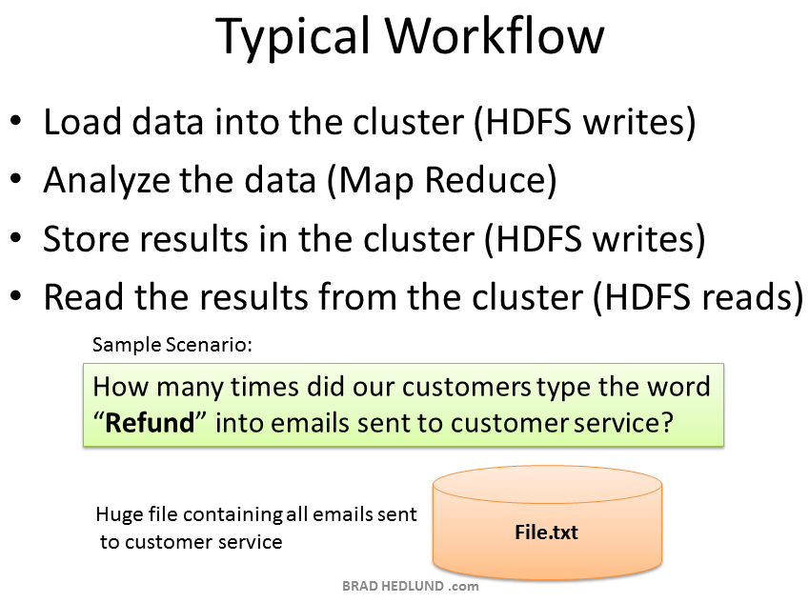

Slide 7
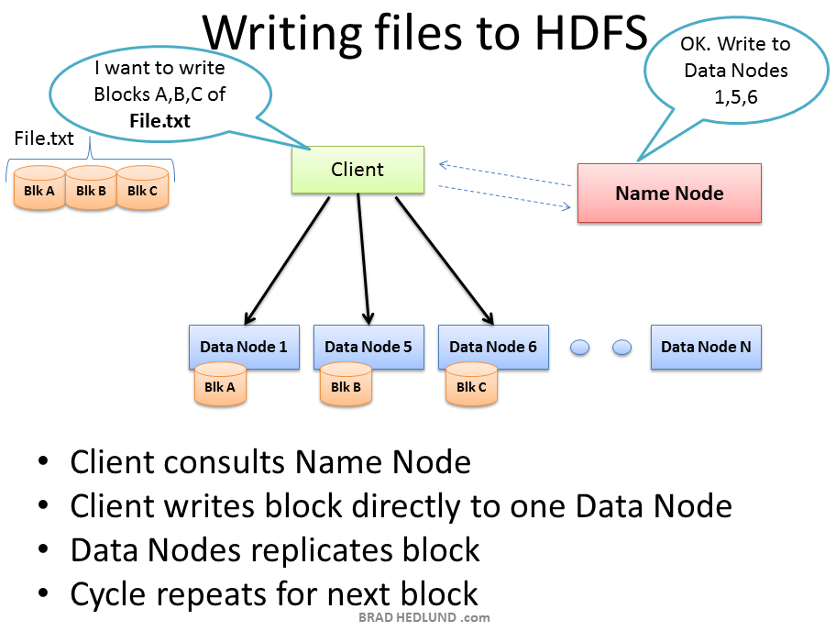

Slide 8
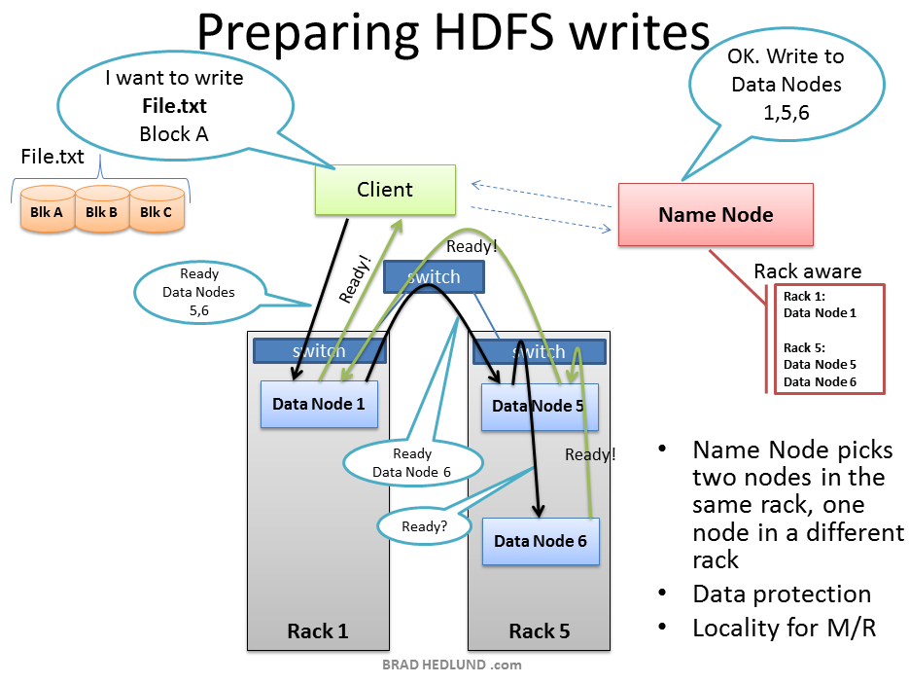

Slide 9
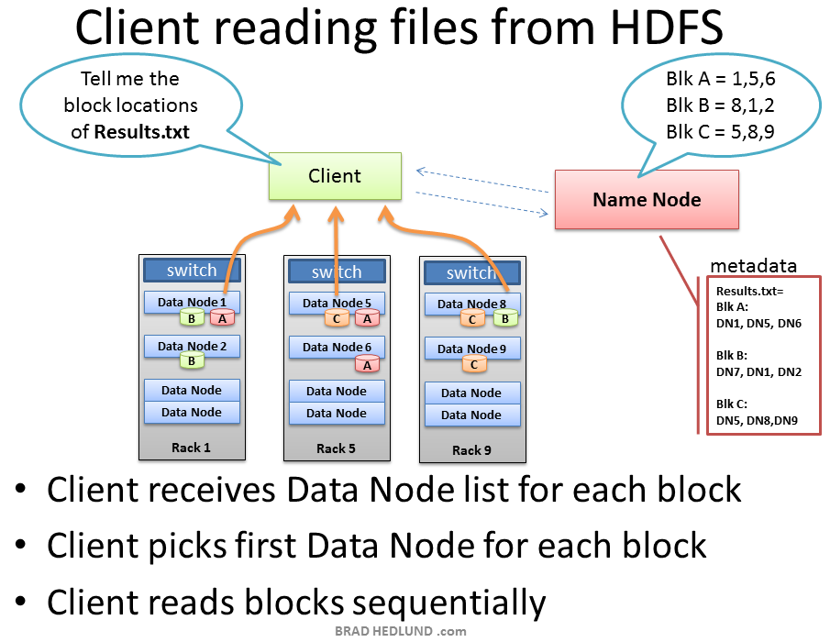

Slide 10
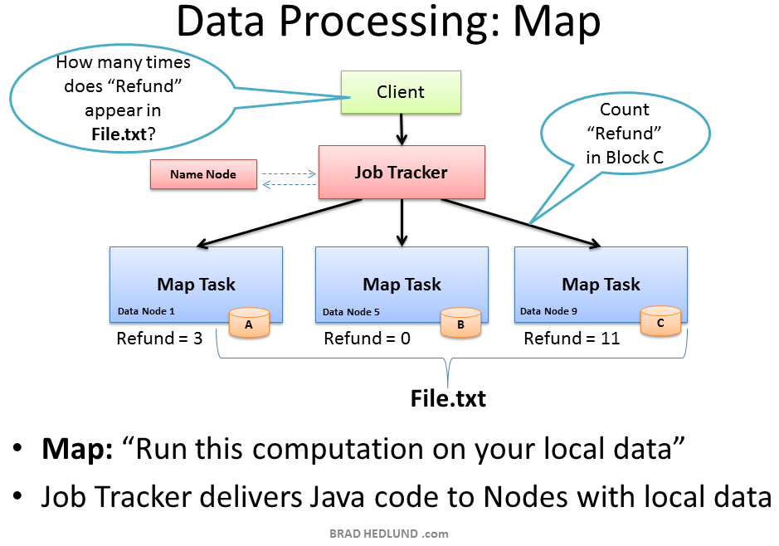

Slide 11
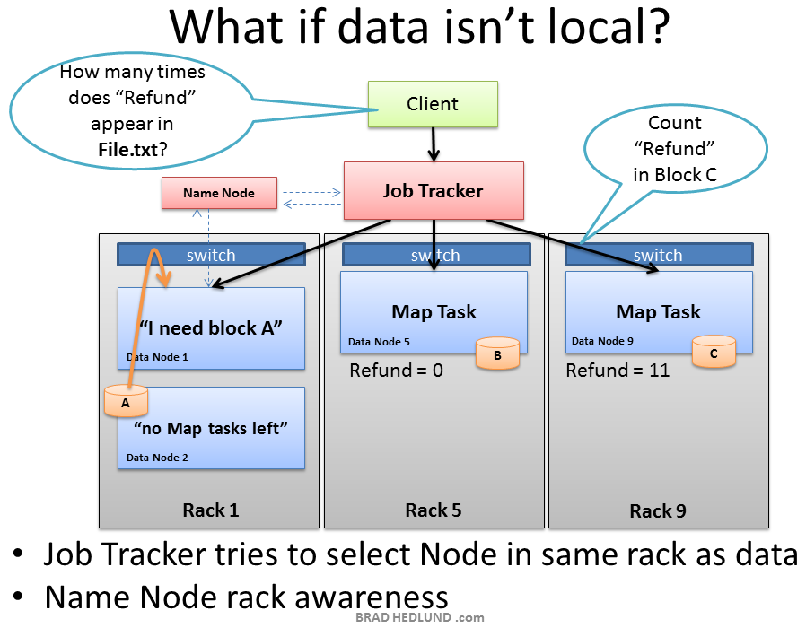

Slide 12
